Slide 1
The Basics of CSS
Understanding Cascading Stylesheets
Khurram Raheel

Slide 2
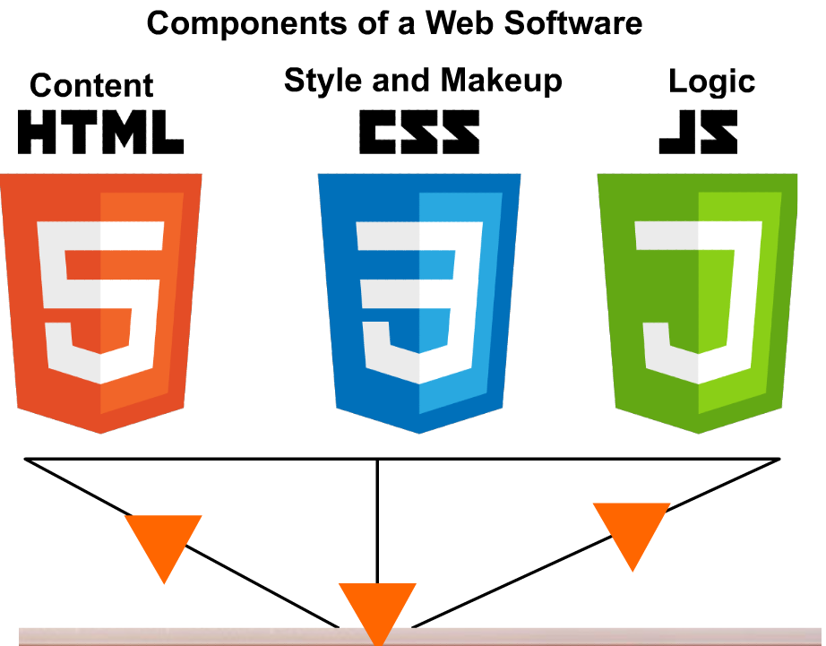

Slide 3




A Web document
CONTENT, MATERIAL
LOOK AND DESIGN
USER INTERACTIVITY

Slide 4

FaceBook site without CSS

Slide 5
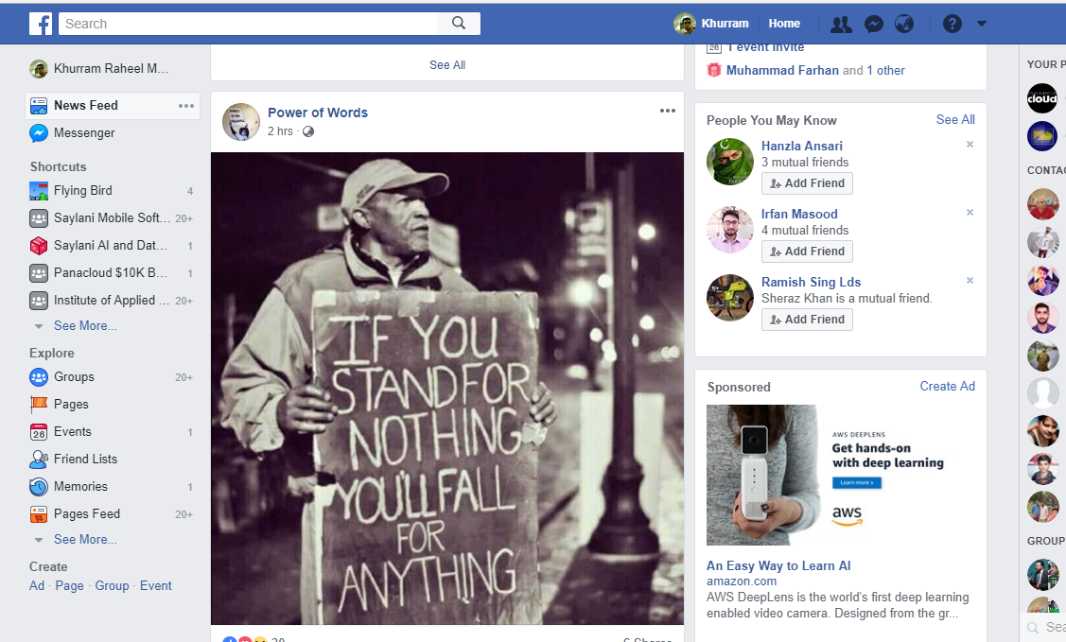
Facebook site with CSS

Slide 6



Why use CSS?
CSS (Cascading Stylesheets) is a rules based instructions used to set the size, appearance and position of HTML elements.
Coloring
Position
Sizing
Animations

Slide 7

Selecting a correct Image for your application!

Slide 8
Selecting a correct Image for your application!
jpg
png
gif
svg

Slide 9

Jpg
Best for real world
Images.
Very large color list
Not transparent

Slide 10
GIF
Animated images
Can be transparent

Slide 11
SVG
A vector image format for two-dimensional graphics with support for interactivity and animation.
Resolution dependent content
Doesn't lost the quality on resizing
Transparent

Slide 12
PNG
A format mostly used for real or unreal objects but with
transparent backgrounds
Resolution dependent content
Do not have a wide color library as JPG
Transparent

Slide 13
SVG

Slide 14
SVG

Slide 15
SVG
Distance
Ratio

Slide 16
SVG
Distance
Ratio
Distance
Ratio

Slide 17
SVG
Distance
Ratio
Distance
Ratio

Slide 18
SVG
Distance
Ratio
Distance
Ratio

Slide 19
SVG
Distance
Ratio
Distance
Ratio

Slide 20
Including CSS in HTML
External Styles
Internal Styles
Inline Styles
Internal Styles
Create a <style> Add your CSS rules in here! </style> in the html file.

Slide 21
Getting started!
Syntax>
query { css-property-name : property-value ; css-property-name : property-value; } query defines the selection of HTML elements we need to target for CSS
div { color : blue; }

Slide 22
SELECTING HTML ELEMENTS
We can select HTML elements from multiple ways:
1). By tag name div { color : green;
font-size:10px; }
2). By id #myElement { color : green;
font-size:10px; }
2). By class .countries { width:100px;
Height:150px; }
<span class = “countries” >PAK></span> <span class = “countries”>IND</span>
<span class = “countries”>IRN</span>
<input id = “myElement” />

Slide 23
SELECTING HTML ELEMENTS
5). By attribute [data-name = namebox ] { color : green;
font-size:10px; }
<input data-name = “namebox” />

Slide 24
SELECTING HTML ELEMENTS
Advanced Queries
div span input { }
<div> <span> This is my span <input type=“text” />
</span> </div

Slide 25
SELECTING HTML ELEMENTS
div span input
Empty space means inside
<div> <span> This is my span <input type=“text” />
</span> </div

Slide 26
SELECTING HTML ELEMENTS
span.countries
All span tags with the class “countries”
<span class=“countries”></span>
<span class=“countries”></span>
<span class=“countries”></span>
<span> span>

Slide 27
SELECTING HTML ELEMENTS
span#name.some
A span tag with ID name and a class some
<span id=“name” class=“some”></span>
<span class=“some”></span>

Slide 28
Boxes
Every HTML element in DOM can be considered as a box which means it has a specific position(left, right, top and bottom) and size(i.e. width and height)

Slide 29
Boxes
<style> div {
width : 100px; height :100px;
}
<style>
<div> </div>

Slide 30

inline elements
SPAN
SPAN
Inline elements take space only as much as their
content needs!

Slide 31
Block elements
DIV
DIV
Block level elements always
take whole horizontal space
regardless of their content!

Slide 32
Block elements
Can take Width and Height
margin-top and margin-bottom will work

Slide 33
Inline elements
Cannot take Width and Height
margin-top and margin-bottom will not work

Slide 34
Margin
The distance between a tag and outer space is known as margin.
margin-top
DIV
margin-left
A div with margin-top = 70px
and margin-left = 20px

Slide 35
Padding
A distance within the tag and the tag’s children is known as padding.
DIV
section
A div with padding-top of 50pxl

Slide 36
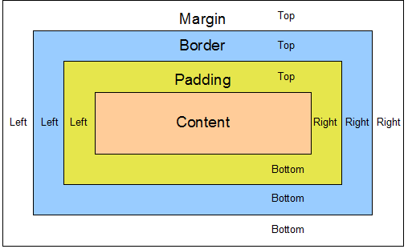
Summary

Slide 37
Mostly used CSS properties
color: ‘green’; border: 1px solid green; background-color: blue; box-shadow:2px 2px 2px 2px blue;
font-size:10px;

Slide 38
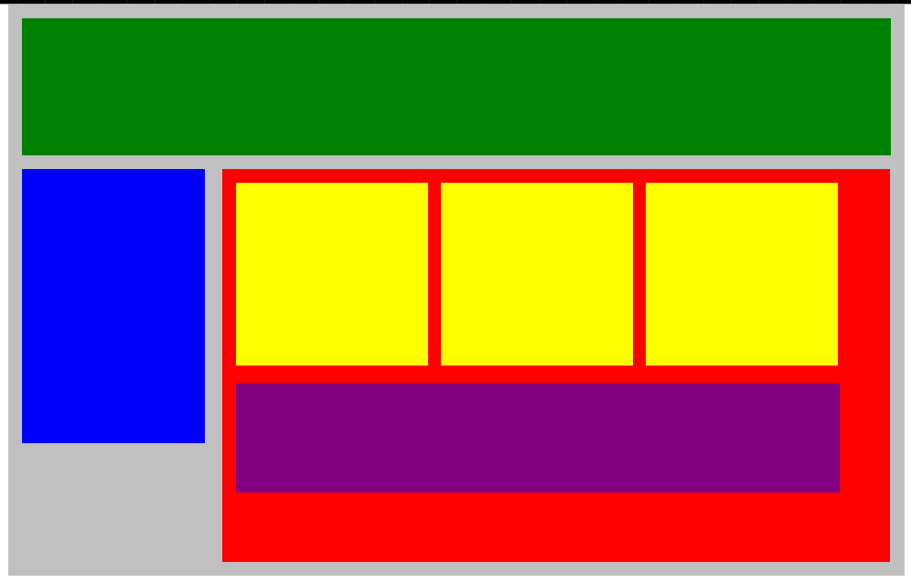
Today’s Assignment

